Slide 1
Stack Gan
組員:林亭家, 彭敬樺, 劉冠鋆, 俞宗伯
日期: 2019/06/21

Slide 2
outline
Introduction
Motivation & Related work
Model Architecture
Experiment
Conclusion
Reference
Notes:
1. Introduction
2. Motivation & Related work
3. Model Architecture (前面先講stage1&2的input output)
4. Experiment (sample 的text&image), Loss graph
5. Conclusion
6. Reference

Slide 3
Introduction
Goal : Synthesizing high-quality images from text descriptions (Text-to-image) .
Problem :
Can’t get the distribution of high resolution.
Previous works : GAN-INT-CLS, GAWWN
Notes:
1. 目標：
要做Text-to-image的生成
2. 問題： 無法在high resolution有良好的表現。
原因： 因為高解析度圖的機率分布很難由GAN的generator去train出來
過去的例子： GAN-INT-CLS, GAWWN

Slide 4
Motivation
Sketch-refinement process
Two Stage:
Stage-I GAN : Low-resolution、shape、color
Stage-II GAN : High-resolution、realistic detail
Conditioning augmentation
Notes:
借鏡畫師畫圖時先畫草稿的理念，由淺入深 (把困難的問題分解成簡單子問題)
先利用stage 1的GAN產生低解析度的圖，在利用stage 2的GAN產生高解析度的圖
為了讓generator更方便生成，我們stage1的input不是word embedding 而是conditioning augmentation，達到類似降維的效果

Slide 5
Input output
Stage I input : Text description
Stage I output : 64*64 Low resolution graph
Stage II input : 64*64 Graph + Conditioning augmentation
Stage II output : 256*256 High resolution graph
Notes:
Model input : text description
Stage I GAN generator output : 64*64 low resolution graph
Stage II GAN input : 64*64 graph + conditioning augmentation(seen as a product from word embedding)
Stage II GAN generator output : 256*256 high resolution graph

Slide 6
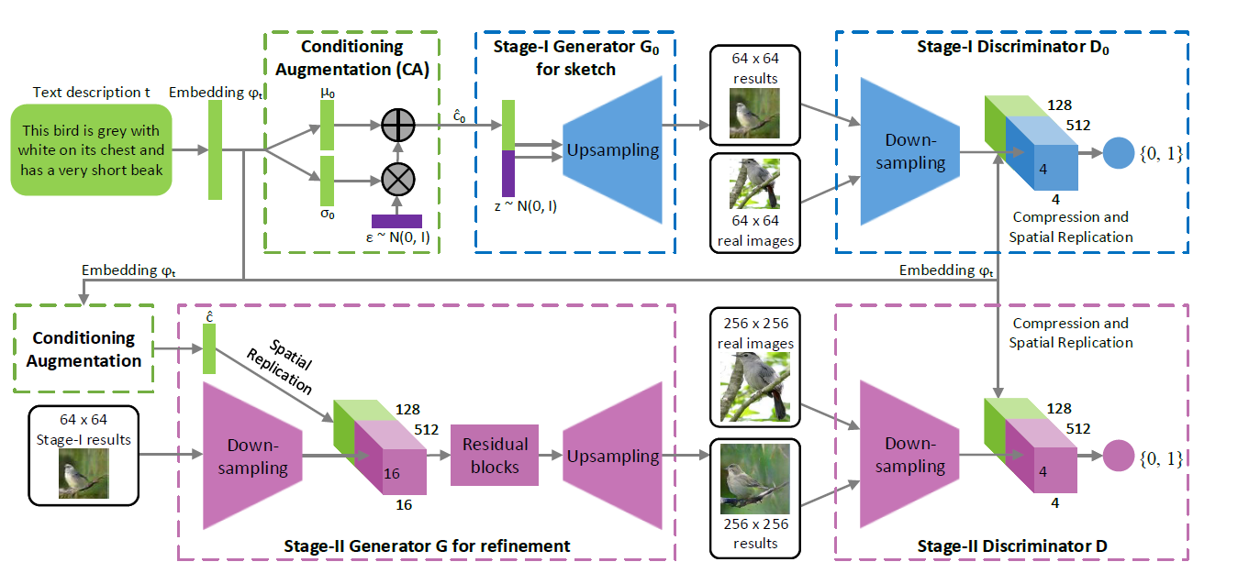
Model
這個block還沒懂，懂的人求寫ppt這部分

Slide 7
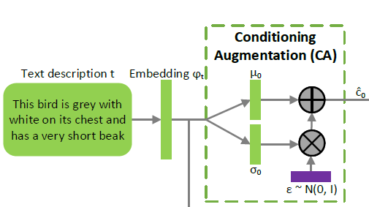
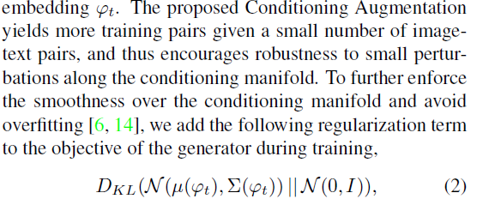
Conditioning augmentation
Latent space for the text embedding is usually high dimensional.
Feed the input into a fully connected layer to calculate a Gaussian distribution after word-embedding.
And samples a 隱藏變量(c^?) from the Gaussian distribution as the input of model generator.
這段感覺重要但還沒懂
Notes:
不希望Word-embedding作為model generator input，
因為維度太高(因為我們句子也就幾個字而已)會使input 在latent space(可想成特徵空間)上太sparse，不利於training
故在input做完word-embedding以後接一個fully connected layer,
來計算一個獨立的gaussian distribution (其中mean, variance 為word embedding 的函數) 並隨機採樣一個隱藏變量作為model generator input

Slide 8
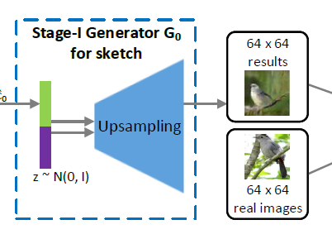
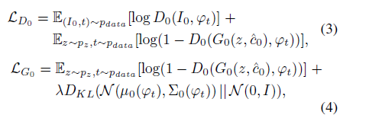
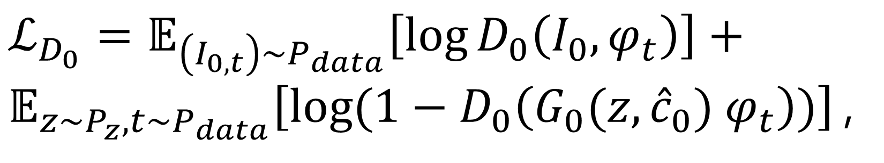
Stage I Generator(upsampling)
$ℒ_{D_{0}}=𝔼_{\left(I_{0,t}\right)\sim P_{data}}\left[\log{D_{0}\left(I_{0}, φ_{t}\right)}\right]+𝔼_{z\sim P_{z},t\sim P_{data}}\left[\log{(1−D_{0}\left(G_{0}(z,{\hat{c}}_{0}) φ_{t}\right))}\right]$,
公式貼爽的，我覺得不用解說
Notes:
公式貼爽的，我覺得不用解說

Slide 9
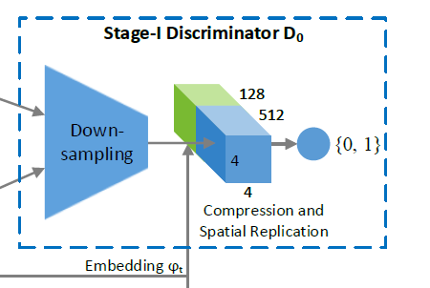
Stage I Discriminator

Slide 10
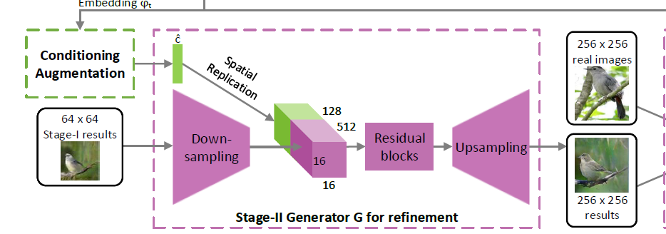

Stage II Generator
這頁我還沒搞清楚，主要residual block的地方
Notes:
這頁我還沒搞清楚，主要residual block的地方

Slide 11
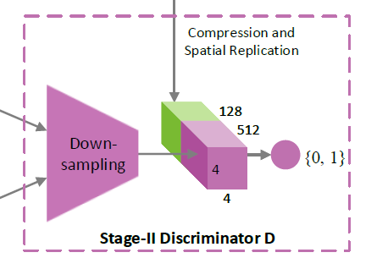

Stage II Discriminator

Slide 12
Experiment
Sample text -> image

Slide 13
Experiment
Stage I Loss Graph
Stage II Loss Graph

Slide 14
Conclusion
這個方法屌爆了，請給我們最高分
Notes:
Success or fail ?
Weakness and possible reason ?
Future Work ?

Slide 15
Reference

